Slide 1
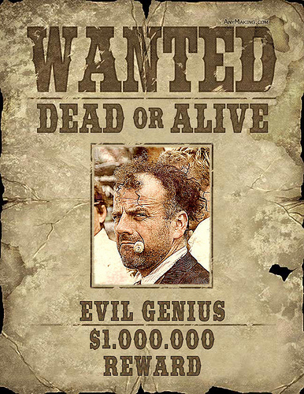
Wanted Posters
Take notes! You will be quizzed.

Slide 2
Objectives - Students will learn to:
Identify physical traits that communicate character identities.
Identify the difference between visual and actual texture.
Create a unique, comedic, and visually appealing wanted poster.

Slide 3
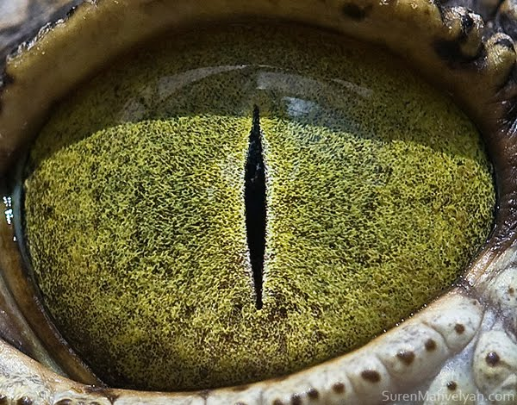
*What features make
predators look sinister?
Eyes pointing forward. Squinty eyes. Slit eyes.
Broad shoulders or jaws for biting!
Fangs, claws, spikes.
Lanky limbs for chasing.
If an animal has large hands what kind of damage could it do?

Slide 4
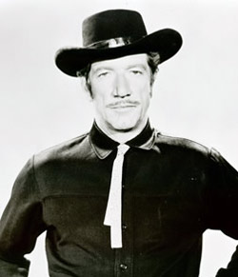
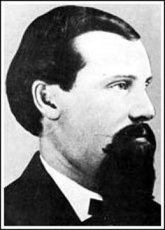
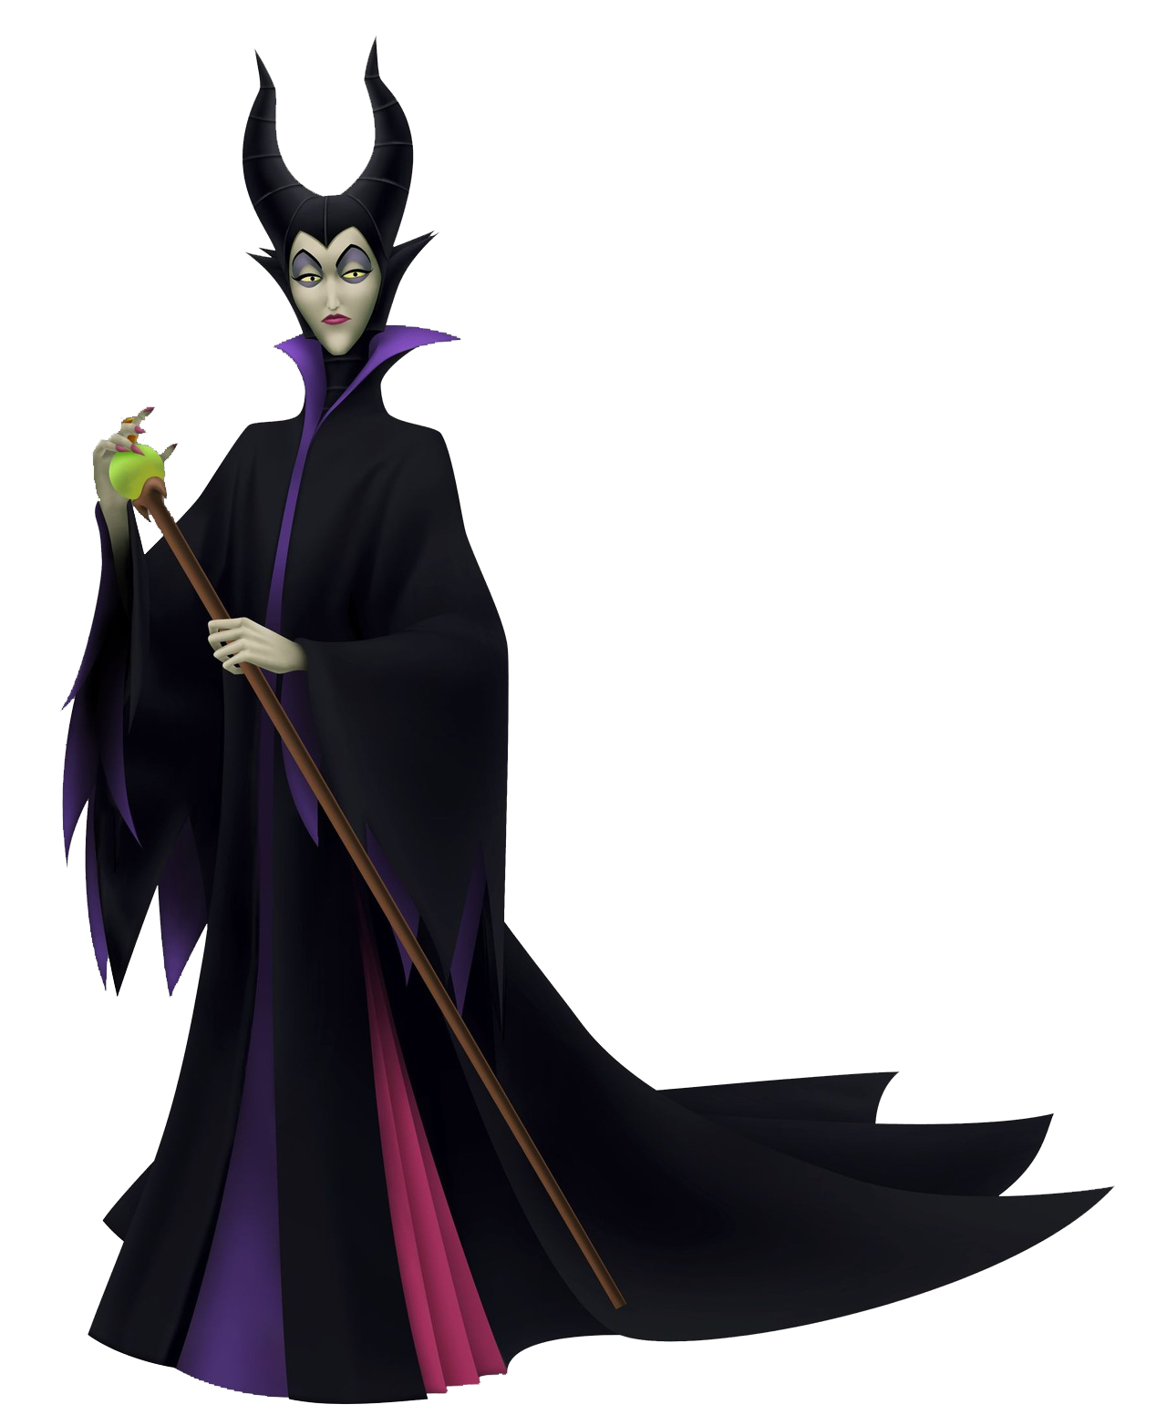
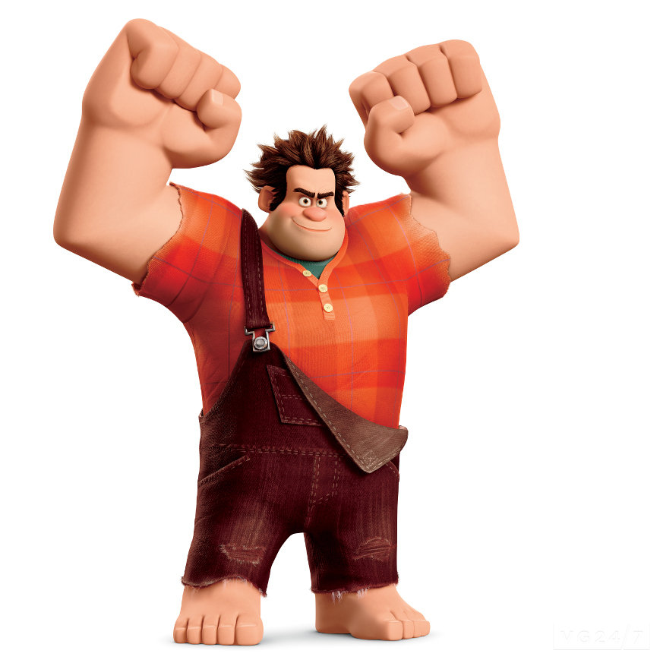
What makes a bad guy look bad?
-Discuss with your group some physical aspects of bad guys, share with the class.
*Write down some of those physical aspects!

Slide 5
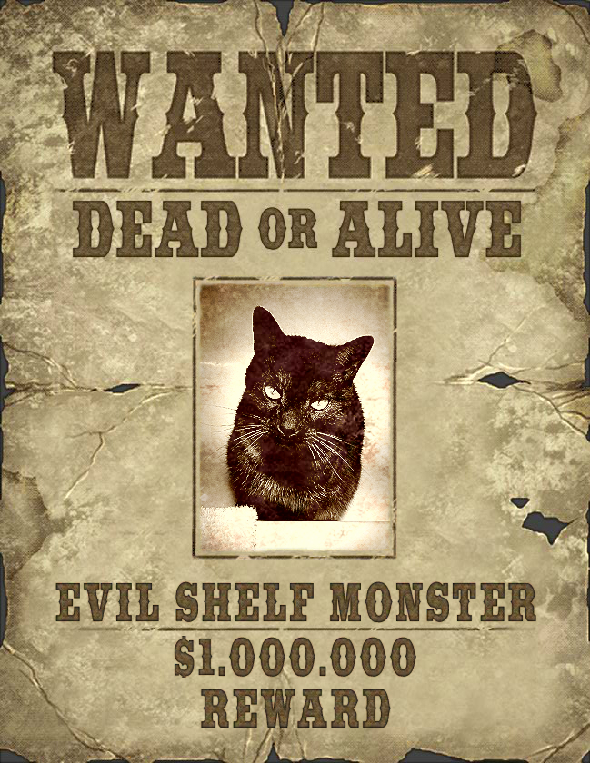
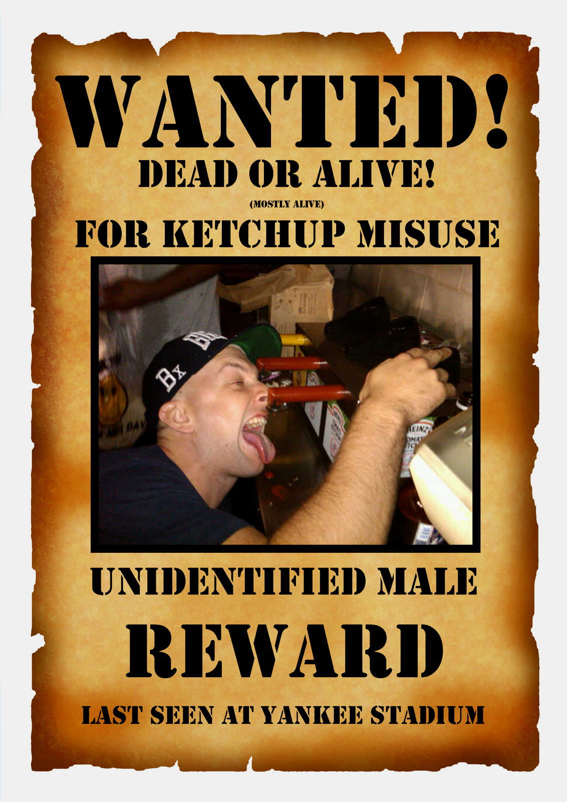
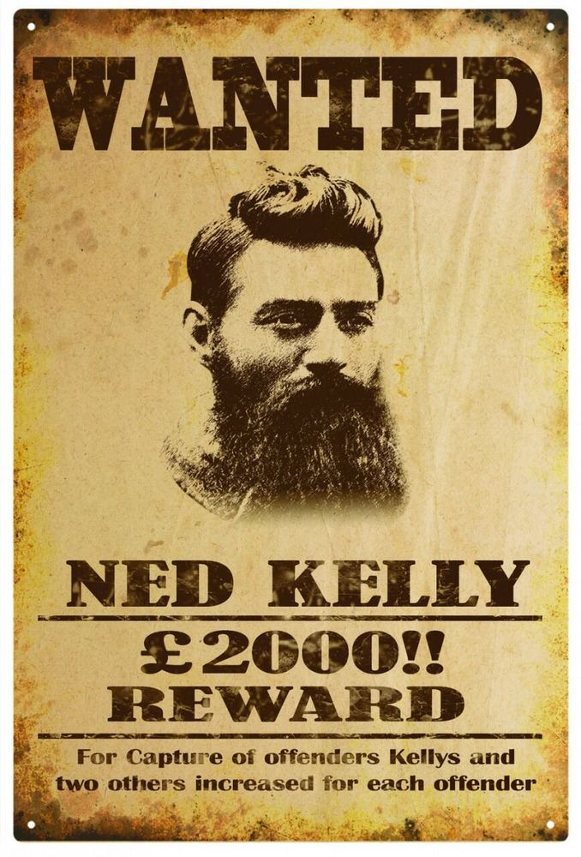
Wanted Poster Examples
What are some common themes in these posters?

Slide 6
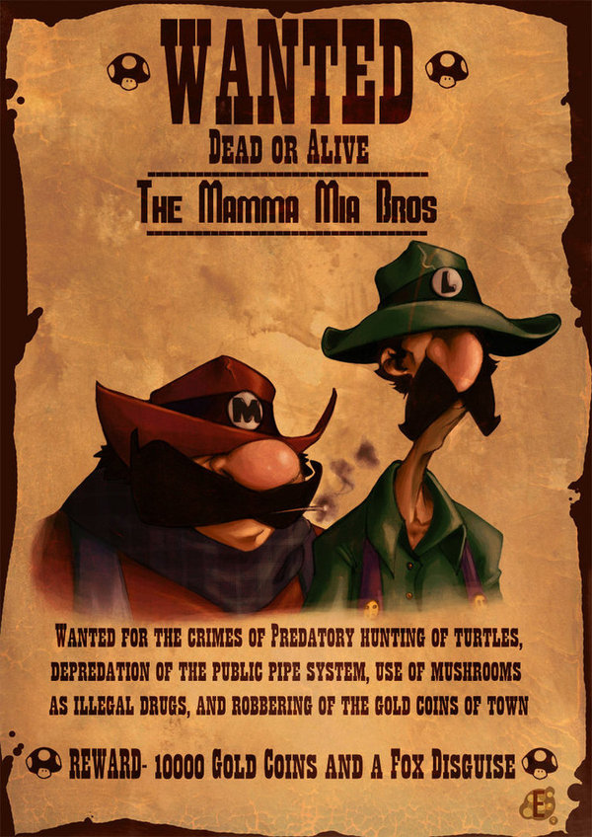
Common Themes in Wanted Posters
WANTED in big bold letters to get
attention.
Images of perpetrator.
Description of crime.
What the reward is.
Old paper look.
“Distressed” VISUAL texture.

Slide 7
*Wanted Poster Project Expectations
**No violent descriptions or inappropriate text.**
Font: Must be BIG and BOLD!
Must include: WANTED, Name, crime, reward, image, paper background, textures.
Photo must be edited to make the character look more sinister, or funny.

Slide 8
*Resources
Images: You may use a photo you took of yourself or an animal. Or find one online at: http://www.morguefile.com/
Photoshop: I will demo how to make a wanted poster.
Textures: CGtextures.com has tons of free paper textures.

Slide 9
*Project Specs and Turn In
Final Size: 8”x10”
300 pixels per inch
Saved as a JPEG or PNG at highest resolution.
Email to: Orellana_Renita@svvsd.org Title Email: Computer Graphics Wanted Poster

Slide 10
Quiz: Wanted Posters!
Name at least 3 things that make a predator look sinister.
What style of font do wanted posters use and why?
What type of texture did we use in this project: Visual or Actual?
What layer modes can we use to add textures on top of our images?

