Slide 1
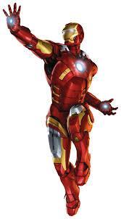
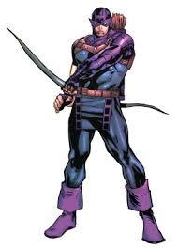
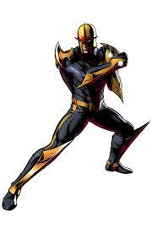
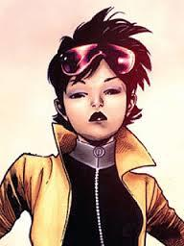
Type Paths
* = write this
* at top = paraphrase slide

Slide 2
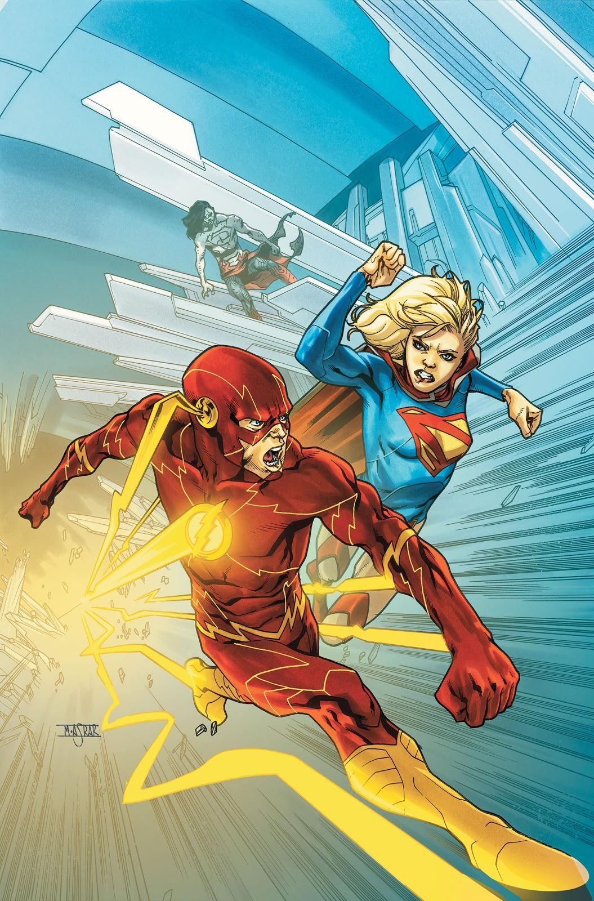
Super Heroes!
Super heroes represent the best and worst attributes of mankind. They tell our stories in fantastical ways, to inspire us.
You will pick your favorite hero to make a tribute to, using imagery and text.

Slide 3
*Objectives! Students will be able to:
Use the pen tool to make paths into shapes that represent super heroes.
Use the type tool to add text that fits the shape.
Use the functions in the type tool to make the text fit the shape.
Find and use words/synonyms that define their hero.
Identify color themes.
Reflect on their work with an objective critique.

Slide 4
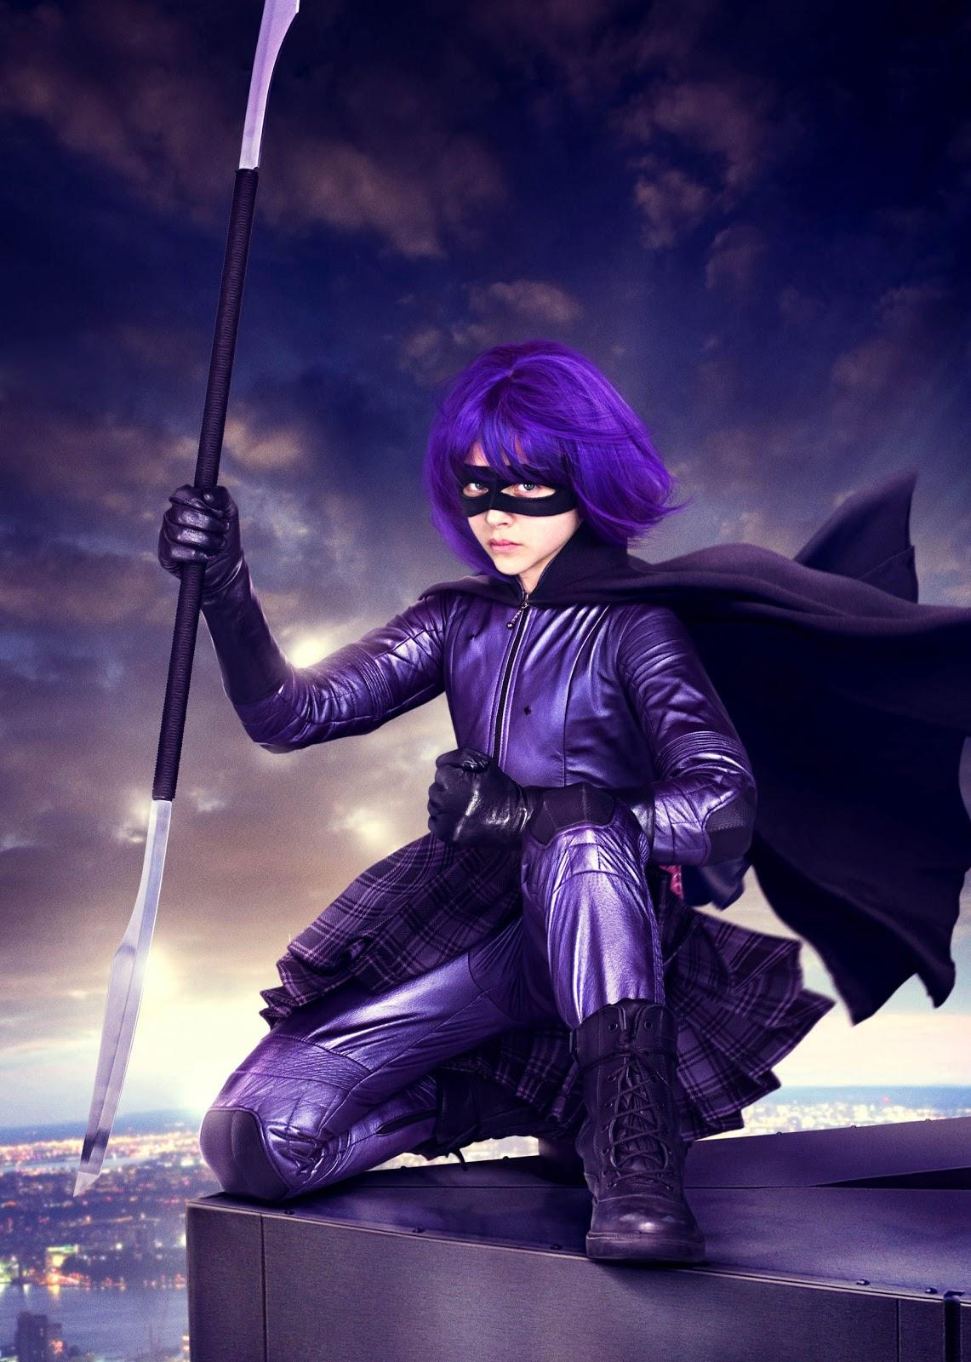
*Color Theory
Primary Colors: Red, Yellow, Blue.
Secondary Colors: Orange, Green, Purple.
Tertiary Colors: Red-orange, Yellow-orange…
Warm colors: Red, orange, yellow.
Cool colors: Green, blue, purple.
Neutral colors: Brown, black, white.

Slide 5
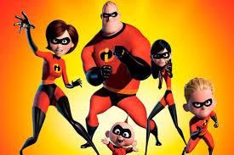
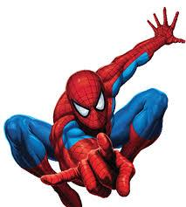
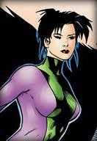
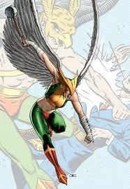
What colors-themes are these?

Slide 6
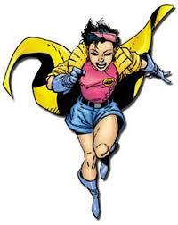
Discuss with at least 1 other person
Take 5 minutes to research super heroes.
Discuss: Your 2 favorite heroes or characters, and what colors/themes are part of their outfits.

Slide 7
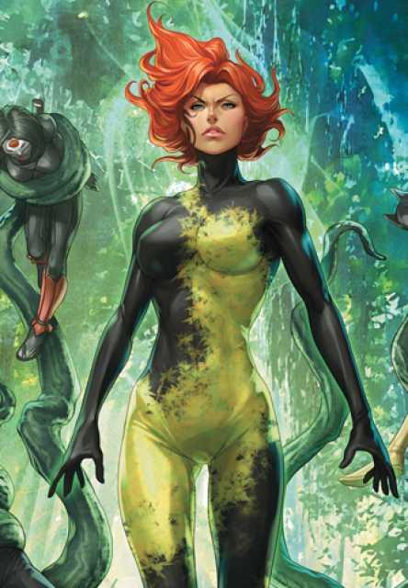
*Defining Character Traits
Each character has something about them that stands out, and makes them easily recognizable.
It could be representative of their power, or it could be a very obvious physical trait.
Poison Ivy’s hair really stands out!

Slide 8
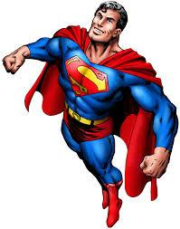
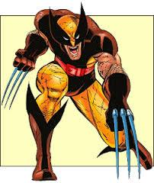
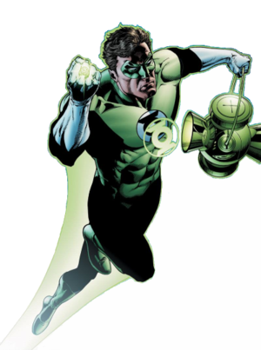
What are the defining visual aspects of these heroes?

Slide 9
*Our Project: Represent your hero
Use the pen tool to make paths.
Fill the paths to make shapes.
Use the paths to type in the shapes.
Define your hero using words in the text.
Change the color/opacity of the text.
Arrange the shapes using balance and composition.
Use a visual texture on top to add interest.

Slide 10
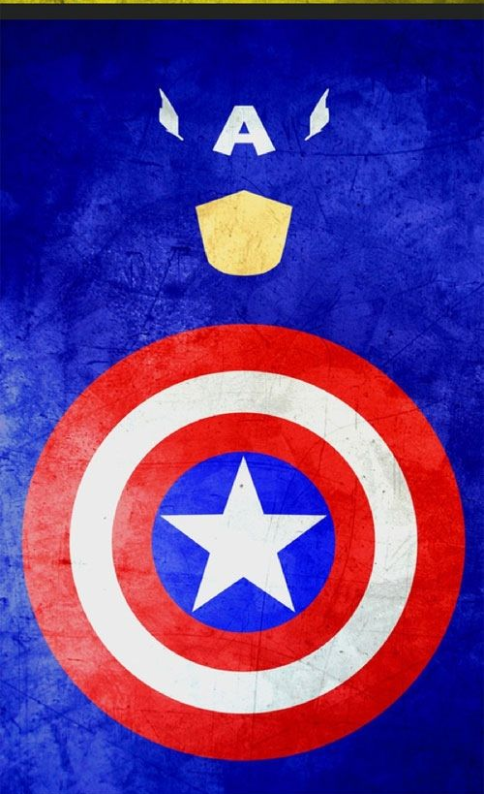
Example (but with text)

Slide 11
Resources:
Pen tool to make shapes:
https://www.youtube.com/watch?v=dSdov7nVYdo
How to fill a path with color: https://www.youtube.com/watch?v=TzNJPfD832Y
How to fill a path with text: https://www.youtube.com/watch?v=P0oebPjErGY

Slide 12
Quiz
Write these questions and the answers in an email and send it to me at Orellana_Renita@svvsd.org
List the primary colors:
List the secondary colors:
List three tertiary colors:
Describe how to make a shape using the pen tool:
Describe how to add text into a path in photoshop:

