Slide 1
Band
Posters
Take notes!
* = Write this
* at top = write
all of this

Slide 2
YOU’RE HIRED
Your favorite band has contacted you to make a *8 inch x 10 inch* poster for their upcoming gig! What do you do?!
Make it, of course. But only if they pay you.
(Your best work will get you paid with an A+ for the assignment).

Slide 3
*Objectives! Students will be able to...
Use these functions in photoshop: basic layers, layer styles, textures, selection tools, text tools, shape tools, and make a brush.
Use their skillz to make a poster for a band (or artist) of their choice that includes specific imagery and text quotes.
Find and use ONLY high resolution images in their work.
Work in groups of 4-5 to share their poster ideas and provide/receive critique.
Reflect on their work and identify positive aspects + areas for improvement.

Slide 4
What do these have in common?

Slide 5
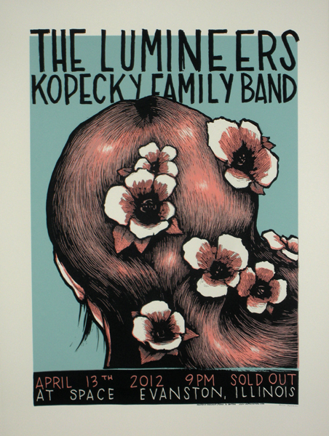
Things to remember
*Composition: Where parts are placed on the canvas to create unity.
Colors communicate emotions!
*Visual texture: A perceived surface quality. Not what we actually feel: Actual Texture.
Text communicates emotions!
*Balance: Distribution of visual elements/weights to create a balanced feel for the overall image.

Slide 6
What do you see in these?

Slide 7
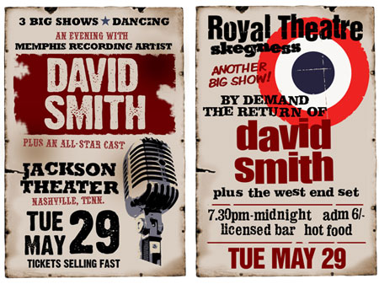
*Combine these elements in your posters
Bold text!
Eye catching imagery.
Colorful/Textures.
Good composition!
Your own brush.
High resolution assets.
8x10 inches 150 or 300 res.
Imagery represents the artist or band.
Your logo

Slide 8
How to find High Resolution files
Go to Google (or a search engine)
Type in “Free high resolution images.”
CGtextures.com
Do not settle for less!
You will be graded down for using low-res files unless there is no other option and we discuss it.

Slide 9
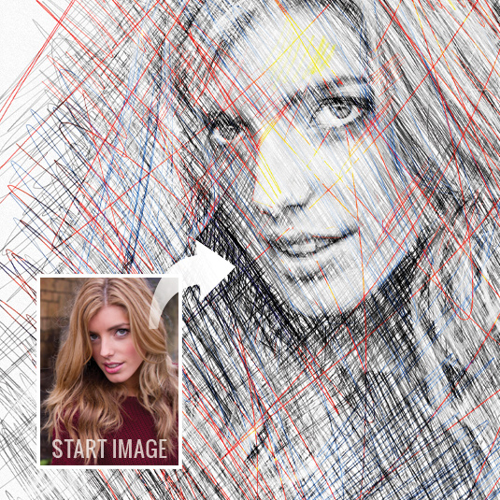
If you have to use a low-res file:
Edit it using filters, textures
and tools to make it look
intentional and artsy!

Slide 10
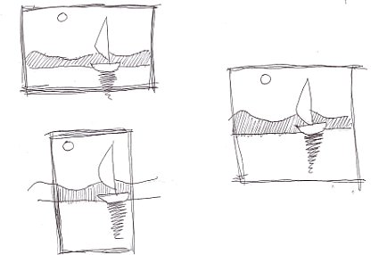
This class...
Spend 30 minutes brainstorming as many ideas as you can on paper.
Spend 10 minutes (or more) with your group sharing ideas.
Start off by sharing the band you chose, what they are about, and your favorite ideas.
One person from the group will record all group names and at least 2 ideas shared per person, and turn it in to me.
Work time!

Slide 11
Quiz
Type these questions and the answers into an email and send it to me Orellana_renita@svvsd.org.
What is composition in a picture?
What is a visual texture?
What is balance in a piece of art?
Describe how you made a special effect or element in your poster.
Describe the process of making a brush to use with the brush tool in Photoshop.

