Slide 1
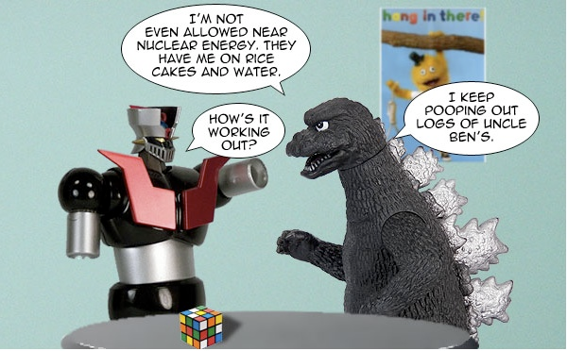
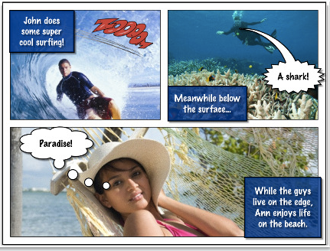
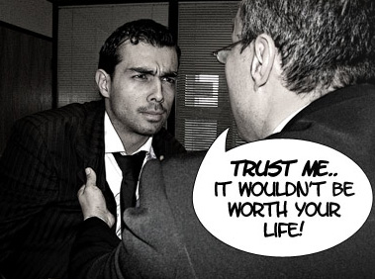
Photo Stories
* = write this
* at top = paraphrase slide
Notes:
http://www.youtube.com/watch?v=H1dOa2XO3js

Slide 2
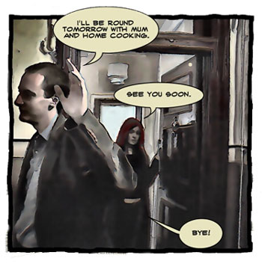
Story Time!
On your own or with a group: Tell a story using edited photos! It must include all 4 elements of a story, and original or edited photos.

Slide 3
*Objectives!
Take photos of yourself or classmates acting as characters, or find high resolution images online.
Use the technique from the tutorial video to make the photos look like a comic.
Make an interesting comic with a beginning, middle and end that has characters.
Add text to the comic, narration or dialogue.
Identify the elements of a story.
Reflect on their work with an objective critique.

Slide 4
Elements of Art
Contrast: A distinct difference between elements of a composition.
Example: Black/white. Texture/no texture.
Line: A mark that connects two points.

Slide 5
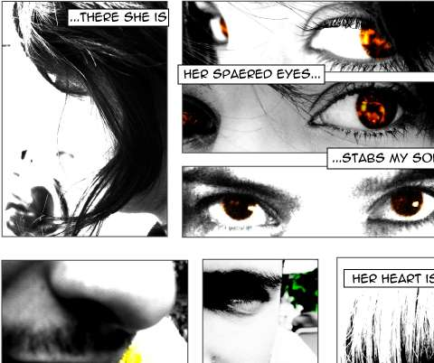
*Elements of a story
Beginning/Rising action
Middle/Conflict
End/Resolution
Characters: hero, anti-hero, villain.
How is contrast used in this image?

Slide 6
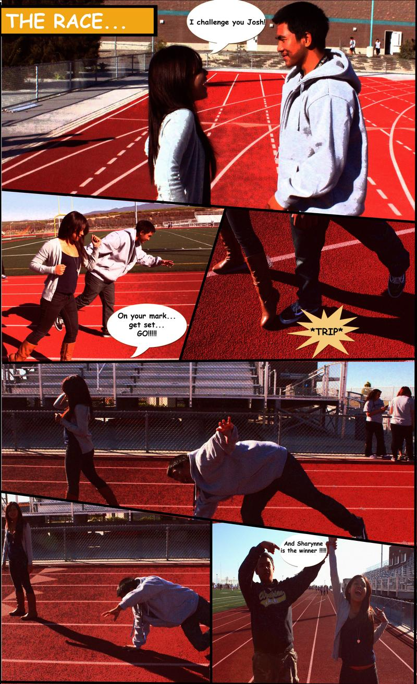
What is the story here?

Slide 10
Story Time: 2 minutes each
You need: Paper and pen/pencil
Fold paper into quarters (4 sections).
Draw a beginning to the story in the first panel.
Pass the paper to your right.
Draw a continuation of the story in the next panel.
Continue this pattern until both sides of the paper are full.
Keep in mind that there will need to be a beginning/middle/end, so keep the story going until the end!

Slide 11
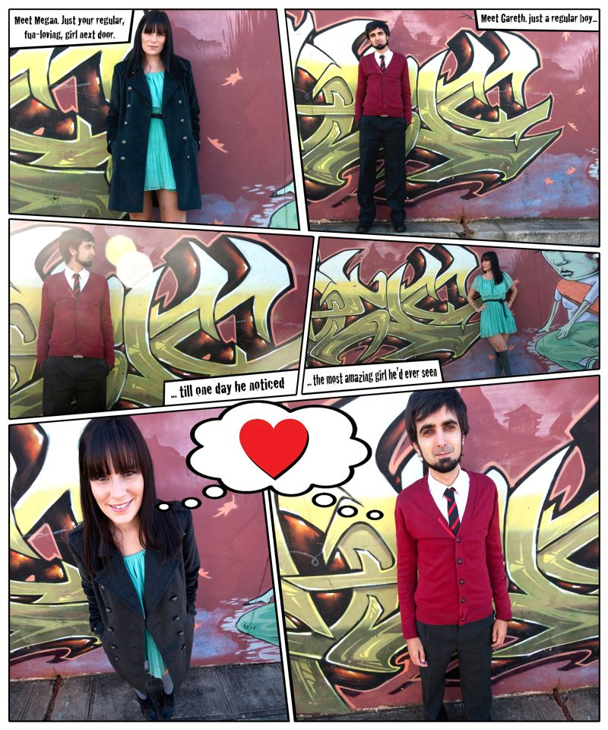
*Interesting Camera Angles
Looking straight at something can be BORING.
Bird’s eye view: from above.
Worm’s eye view: from below.

Slide 12
Cool close ups!
*What is in the frame helps tell the story! Zoom in on important motions/objects.
How does the close up of their hands help tell the story?

Slide 13
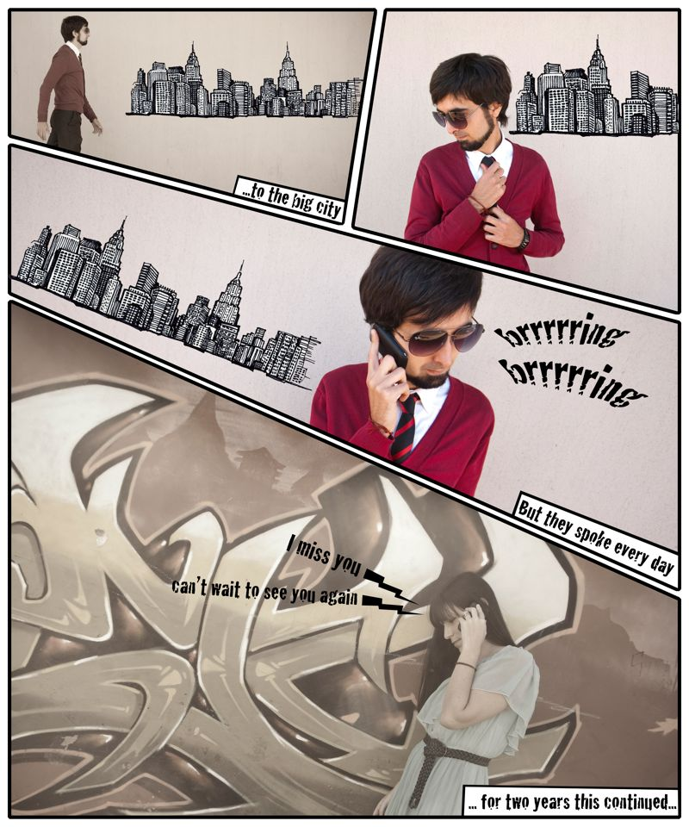
Varied Frames
*Make your frames interesting! Don’t just stick with basic squares.
Diagonals! Zig zags!
How do we use line here?

Slide 14
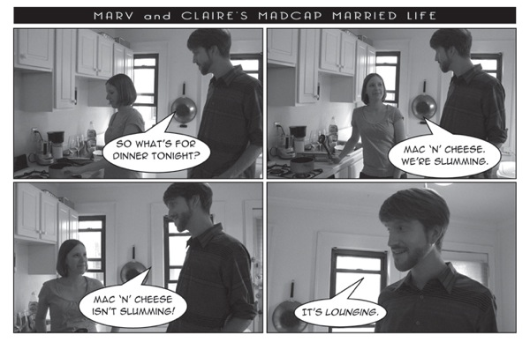
*Project Requirements
300 pixels per inch.
8” by 10”.
Must be edited photos.
Must use technique from tutorial.
Must be 3+ pages/4+ panels per page. (Group = 2+ pages per person)
Must include text as dialogue or narration.

Slide 15
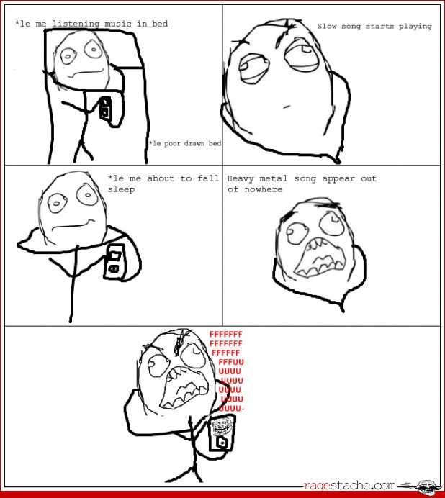
Project Thumbnails
Before you collect images, you need A PLAN!
Draw basic stick figure drawings of your story on 3 pages, include any text.
Get it approved by Mrs. O.
Start on your official project.
Sketches due by end of class.

Slide 16
School Cameras
Check out list.
Check memory card.
RESPECT the equipment.
Do not disturb other classes.
Stay on school property.
Save images to your student share.

Slide 17
Quiz: orellana_renita@svvsd.org
What is high resolution?
What is contrast in art?
What is line in art?
What are the 4 elements of a story?
List 3 photoshop tools or techniques that you used.

