Slide 1
Logo Design
Please take notes! You will be quizzed at the end of this unit.
* = write this.

Slide 2
Graphic Design: Logos
This is an intro to graphic design, with a focus on the basics of logo design. Students will write a mission statement for themselves (a list of defining aspects of themselves, or their goals) and then develop logos based on that mission.
Each student will develop a logo to be used on all future assignments.

Slide 3
Graphic Design: WHAT is it?
*The practice/profession of creating various forms of visual imagery for use in publications, advertisements, packaging, or websites.
19th Century: William Morris is considered the father of graphics. During this time, his Kelmscott Press to produce many graphic designs, and a collectors market for them. Morris, Burne-Jones, and Dante Gabriel Rossetti formed the Pre-Raphaelites, whose ideas have influenced modern graphic design considerably.

Slide 4
Logos
*Definition: A name, symbol, or trademark designed for easy recognition. They represent the identity or goals of a brand, product, or idea.
In History:
13th Century - Trademarks for merchants, blacksmiths, masons, watermarks and crests.
19th Century - Industrial manufacturing hit and people needed to ship products faster and be internationally recognized.

Slide 5
What do you think these companies do?

Slide 6
*What makes a GOOD logo?
Unique
Reproducible: re-size, color, b&w, fabric, web.
Follow basic design principles: space, color, form, clarity.
Represents the company.
Speaks to the target audience.

Slide 7
*GOLDEN RULES of logo design
Goal: A logo should clearly represent an organization’s identity.
1) Keep it simple!
2) Should be effective at large and small scale.
3) Should be effective in color and b&w.

Slide 8
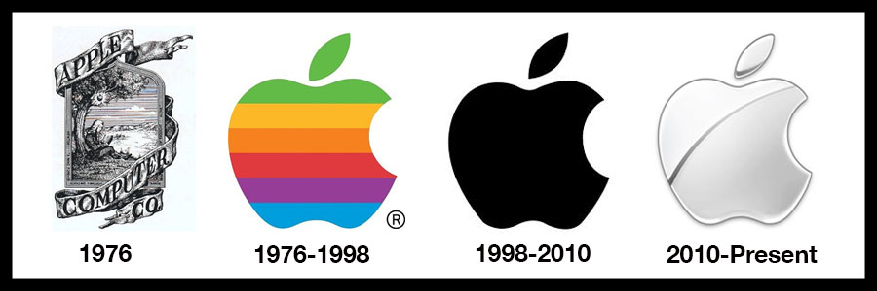
Keep it SIMPLE. Simple. SIMPLE.
Less info = easier to recognize and remember.

Slide 9
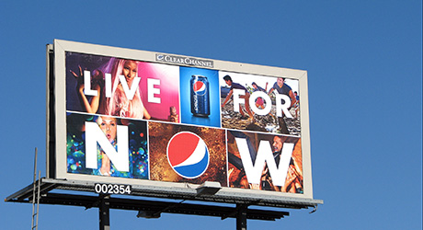
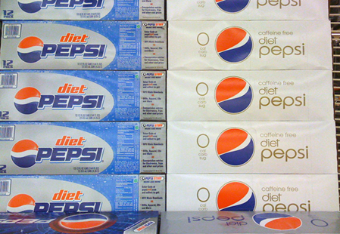
Effective BIG and small
Because sometimes it’s a tiny thing in the corner, and other times it’s a whole poster.

Slide 10
Effective in Black and White
Because sometimes you can’t print in color.

Slide 11
*Two Types of Logos
Descriptive: how do these
designs describe their brand?
Symbolic: Apple chose this logo because the apple represents knowledge, and the bite represents you taking a bite out of knowledge using their products.

Slide 12
*Fonts and Color
Font and color choices change the message.
Fonts are descriptive!
Example: Bold letters communicate confidence.

Slide 13
What do these fonts say about the brand?

Slide 14
*Color Creates Emotions
Red and yellow are a stimulating color combination, creating a feeling of urgency and hunger.
Brown reminds us of shipping boxes/paper, and represents being solid and reliable.

Slide 15
Logo Design Steps:
Research and brainstorm.
Think about fonts.
Turn your ideas into forms and identify color.
Finalize your design.

Slide 16
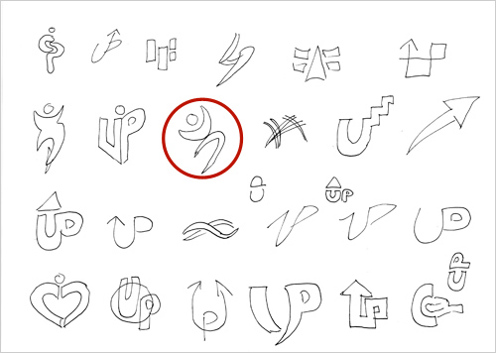
Research and Brainstorm
Analyze and define what you are trying to represent (you).
Think, write and sketch!
Develop a list of attributes and characteristics that define your goals.
Every idea is relevant!

Slide 17
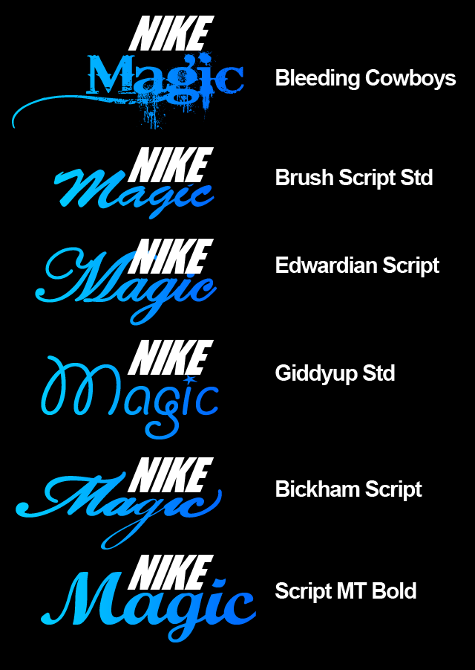
Think about Fonts
Type your name/initials/company name in many types of fonts.
See how the personality changes each time.
Choose at least 3 of the best and start combining them with icons or symbols.
Try upper case and lower case. What does it do?

Slide 18
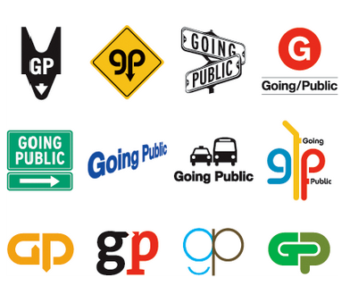
Forms and Color
Try starting with forms that are recognizable, but add your own twist.
Combine letters with graphic elements and color to create a unique logotype.
There are so many options! Don’t be afraid to experiment!

Slide 19
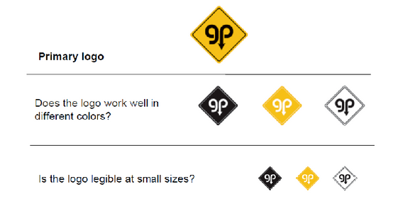
Finalize your Logo
Think about how your logos can be used, and make sure it will work for all purposes! You could create a simpler, secondary logo for tiny prints.

Slide 20
Quiz: Graphic design and logos
What is graphic design?
What are logos?
Name 2+ things required for a GOOD logo.
What are the golden rules of logo design?
Name a color combo and what emotions it might invoke.

